Slide 1
The Eclipse Communication Framework (ECF)
  Chris Aniszczyk <zx@us.ibm.com>
  Scott Lewis <slewis@composent.com>
  March 20th, 2006

Slide 2
What You Need
To get the most from this tutorial, you need to bring a laptop capable of running Eclipse and developing plug-ins.
You must have the following installed:
  Eclipse 3.2 M5a (or M5)
  EMF 2.2.M5 and GEF 3.2M5a
  ECF SDK 0.7.5
  ECF Plugins w/source (via project set file or anon CVS)

Slide 3
Tutorial Overview
Introduction, Demos: IM/Chat, Collaboration, Shared Editor, VOIP/Call API
Module 1: ECF Clients
  ECF Clients
    Trivial client
    IM/Chat
    Datashare
    Discovery/FileShare
    Extensibility with Shared Objects
Module 2: ECF Providers
    ECF protocol adapters revisited
    Namespace Extension Point
    ContainerFactory Extension Point

Slide 4
Tutorial Overview (cont)
Module 3: You Decide
  IM Clients
  Multiplayer Game
  Shared Editor
  Other

Slide 5
Demos
XMPP IM/Chat
IRC
Collab
  Chat
  URL Sharing
  Remote view opening
  Shared Workspaces/Editor

Slide 6
ECF Future
New Sub-projects
  Shared Editors
  Call API/VOIP/Asterisk
  Application Sharing/VNC
  ECF+OSGI For Servers

Slide 7
Module 1
ECF API Introduction

Slide 8
ECF: Multi-Protocol Communications for Eclipse/RCP
org.eclipse.ecf.core.IContainer: Interoperability through protocol abstraction
  Container creation: ECF ContainerFactory
    IContainer c = ContainerFactory.getDefault.createContainer(“type”);
  IContainer semantics: connect/disconnect/lifecycle/listeners
    c.connect(ID,IConnectContext);
    ...
    c.disconnect();
  Protocol adapters: aka Iadaptable abuse
    IFileshareContainer fsc = (IFileShareContainer) c.getAdapter(IFileShareContainer.class);
    if (fsc != null) ...

Slide 9
ContainerFactory Extension Point
org.eclipse.ecf.containerFactory
ECF providers implement communication protocol(s)
  XMPP/Jabber, IRC, JMS, ECF 'generic', Yahoo
  Working on: SIP, JXTA, Jingle, Sametime, RSS+SSE
  Relying upon community involvement/contribution
Allows clients/apps to write to IContainer API and not to specific implementation API
  IContainer container = ContainerFactory.getDefault.createContainer(“ecf.xmpp.smack”);
  IContainer.connect(...);

Slide 10
ECF Addressing
Addressing needed for container.connect(ID,...);
Represented by instance of org.eclipse.ecf.core.identity.ID
  Have URI 'nature'
    ecftcp://ecf.eclipse.org:3282/server
    xmpp.smack:slewis@ecf.eclipse.org
    mailto:slewis@composent.com
  Not required to have URI syntax (but frequently do)
    GUID: AF430D2189AFB8D
    String: “channel1”
IDs also useful as service identifiers (e.g. Discovery), user identifiers (IM/chat), file identifiers (fileshare), channel identifiers (datashare)

Slide 11
Extending Addressing for New Protocols
org.eclipse.ecf.namespace extension point
  Plugins provide extension Namespaces
    e.g. xmpp jabber id syntax: jid:slewis@ecf.eclipse.org
  Namespace extensions responsible for creating ID instances that follow ID contract
    Immutable
    Unique within Namespace
  Examples
    ID id1 = IDFactory.getDefault().createID(ns1,”slewis@ecf.eclipse.org”);
    ID id2 = IDFactory.getDefault().createID(ns1,”slewis@composent.com”);
    ID id3 = IDFactory.getDefault().createID(ns2,”slewis@ecf.eclipse.org”);
    e.g. id1.equals(id2) -> false, id1.equals(id3) -> false

Slide 12
ECF Protocol Adapters
IContainer extends IAdaptable: IContainer.getAdapter(interface);
Protocol semantics represented by adapter
  Presence/IM/Chat: IPresenceContainer
  Datashare: IChannelContainer
  Fileshare: IFileShareContainer
  Call API: ICallContainer
  Shared Object API: ISharedObjectContainer
  Others...
Supports runtime querying of supported communications
Providers choose to implement protocol adapters
Example
  IPresenceContainer pc = (IPresenceContainer) c.getAdapter(IPresenceContainer.class);

Slide 13
Building Simple Clients
Create IContainer
Retrieve/setup protocol adapter
Create target ID
Call IContainer.connect(targetID)
Send/receive messages (via adapter)
Disconnect
Dispose

Slide 14
Create IContainer
IContainer c = ContainerFactory.getDefault().
createContainer(“ecf.generic.client”);
Note: Exception thrown if no associated provider installed or initialization fails

Slide 15
Existing ECF providers
Protocol Container Type Name
XMPP (jabber) ecf.xmpp.smack
Yahoo ecf.yahoo.jymsg
ECF 'generic' client ecf.generic.client
ECF 'generic' server ecf.generic.server
IRC ecf.irc.irclib
Java Messaging Service ecf.jms.tcp.client
Zeroconf /Bonjour ecf.discovery.jmdns
datashare ecf.generic.channel
fileshare ecf.generic.fileshare
Sametime ask Chris A
...

Slide 16
ECF Protocol Adapters
//Presence
IPresenceContainer pc = (IPresenceContainer) container.getAdapter(IPresenceContainer.class);
if (pc == null) throw new NullPointerException(“presence container not available”);
else ...
//Discovery
IDiscoveryContainer dc (IDiscoveryContainer) container.getAdapter(IDiscoveryContainer.class);
if (dc == null) throw new NullPointerException(“discovery container not available”);
//FileShare, Call API, others...

Slide 17
ECF (connect) Target IDs
// For connection to container...
ID id1 = IDFactory.getDefault().createID(cont.getConnectNamespace(),”ecftcp://ecf.eclipse.org:3282/server”);
container.connect(id1,null);
// Using some other namespace
ID id2 = IDFactory.getDefault().createID(namespace,
“ecftcp://ecf.eclipse.org:3282/server”);
// GUID(SHA1+Base64)/String ID
ID id3 = IDFactory.getDefault().createGUID();
ID id4 = IDFactory.getDefault().createStringID(“channel1”);

Slide 18
ECF ID properties
IDs instances are:
  Immutable: Don't go changin'
  Unique within Namespace: ID.getName()
  Serializable
  IAdaptable
  URI nature: ID.toURI()
  java.security.Prinicpal

Slide 19
Putting it Together: A Trivial Client
// Create container
IContainer container = ContainerFactory.getDefault().createContainer(“ecf.generic.client”);
// Create target ID for connection
ID targetID = IDFactory.getDefault().createID(container.getConnectNamespace(),”ecftcp://localhost:3282/server”);
// Connect to a target
container.connect(targetID,null);

Slide 20
Putting it Together: XMPP Clients
org.eclipse.ecf.tutorial.ExampleClient1, ExampleClient2, ExampleClient3, ExampleClient4

Slide 21
Protocol Adapter: Datashare
API: org.eclipse.ecf.datashare
Protocol adapter: org.eclipse.ecf.datashare.IChannelContainer
Example
IChannelContainer channelContainer = (IChannelContainer) container.getAdapter(IChannelContainer.class);
IChannel channel = channelContainer.createChannel(id,listener,props);
Channel used to asynchronously send arbitrary data (byte arrays)
channel.sendMessage(“hello”.getBytes());

Slide 22
Datashare Characteristics
Sender Ordering (FIFO). Receivers guaranteed to get messages in same order they were sent
  No stronger ordering guarantees
Datashare Events
  IChannelInitializeEvent – once upon channel creation/initialization
  IChannelGroupJoinEvent – once for every connect/join
  IChannelMessageEvent – once for every sendMessage
  IChannelGroupDepartedEvent – once for every disconnect

Slide 23
Protocol Adapter: Discovery
Discovery API: org.eclipse.ecf.discovery
Protocol adapter: org.eclipse.ecf.discovery.IDiscoveryContainer
Example
IDiscoveryContainer discoveryContainer = (IDiscoveryContainer) container.getAdapter(IDiscoveryContainer.class);
IserviceTypeListener listener = new IServiceTypeListener() { ... };
discoveryContainer.addServiceTypeListener(listener);
Listeners called asynchronously when service types are discovered
To register service types/services
discoveryContainer.registerServiceType("_ecftcp._tcp.local.");
discoveryContainer.registerService(serviceInfo);

Slide 24
Protocol Adapter: Shared Object Containers/Shared Objects
Shared Object API: org.eclipse.ecf.core
Protocol adapter: org.eclipse.ecf.core.ISharedObjectContainer
Example
ISharedObjectContainer soContainer = (ISharedObjectContainer) container.getAdapter(ISharedObjectContainer.class);
ISharedObject so = SharedObjectFactory.getDefault().createSharedObject(“mysharedobject”);
ID soID = IDFactory.getDefault().createGUID();
soContainer.getSharedObjectManager().addSharedObject(soID,so,new HashMap());

Slide 25
Module 2
ECF Client Creation

Slide 26
Yahoo IM Client Creation
This tutorial will cover creating an ECF IM client for the Yahoo protocol (ymsg)
  We’ll use jymsg (http://jymsg9.sourceforge.net/)
The steps will apply to any other type of messaging protocol so we encourage users to create IM clients for their favorite protocol
Reference implementation available via CVS
  ecf1.osuosl.org/ecf/plugins/org.eclipse.ecf.provider.yahoo

Slide 27
Yahoo IM Client Creation
Step 1
  Create an identity
    Create a class, YahooID that extends org.eclipse.ecf.core.identity.BaseID

Slide 28
Yahoo IM Client Creation
Step 2
  Define and register a namespace
    Create a class, YahooNamespace that extends org.eclipse.ecf.core.identity.Namespace
    Register with the org.eclipse.ecf.namespace extension point

Slide 29
Yahoo IM Client Creation
Step 3a
  Create a container instantiator
    Create a class, YahooContainerInstantiator that implements org.eclipse.ecf.core.provider.IContainerInstantiator
    All we need to do here is create an ID via the IDFactory and return a new YahooContainer instance (stubbed)

Slide 30
Yahoo IM Client Creation
Step 3b
  Define a container factory
    Extend the org.eclipse.ecf.containerFactory extension point
  Create three properties
    org.eclipse.ecf.example.collab.ui.JoinGroupWizardPage.usepassword
      true
    org.eclipse.ecf.example.collab.ui.JoinGroupWizardPage.examplegroupid
      <user>
    org.eclipse.ecf.example.collab.ui.JoinGroupWizardPage.groupIDLabel
      “Account”

Slide 31
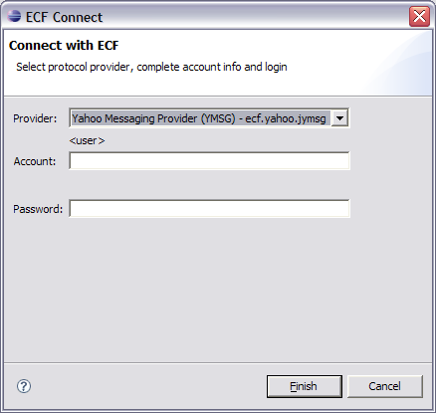
Yahoo IM Client Creation

Slide 32
Yahoo IM Client Creation
Step 4a
  Implement the IContainer interface
    Create a class, YahooContainer that implements org.eclipse.ecf.core.provider.IContainer
  This container will represent the connection to the Yahoo servers

Slide 33
Yahoo IM Client Creation
Step 4b
  Constructor
    Grab the localID
    Create a new yahoo Session instance
    Create a new YahooPresenceContainer

Slide 34
Yahoo IM Client Creation
Step 4c
  connect(…)
    Grab the user information from the targetID
    Login to the Yahoo messaging server
    Populate the initial roster (buddy list)
  Recommend looking at the reference implementation to complete the steps

Slide 35
Yahoo IM Client Creation
Step 5a
  Create a YahooPresenceContainer that extends AbstractPresenceContainer

Slide 36
Yahoo IM Client Creation
Step 5b
  Create a new IMessageSender implementation
    See getMessageSender() in IPresenceContainer
  We will simply send a text message using the jymsg API
    See sendMessage(…) in Session

Slide 37
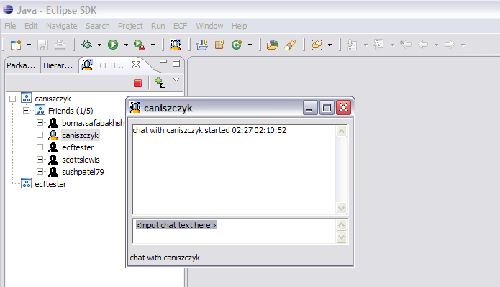
Yahoo IM Client Creation

Slide 38
ECF ScribbleShare Application
This tutorial will cover creating a ECF ScribbleShare application that uses the datashare APIs
Reference implementation available via CVS
  dev.eclipse.org/cvsroot/technology/org.eclipse.ecf/plugins/org.eclipse.ecf.tutorial

Slide 39
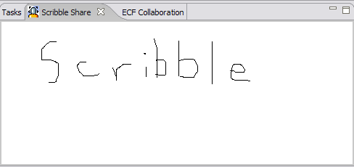
ECF ScribbleShare Application
Step 1
  Create a simple view so we can scribble some stuff
  ScribbleView extends org.eclipse.ui.part.ViewPart
    See BasicScribbleView for reference implementation

Slide 40
ECF ScribbleShare Application
Step 2
  Create a basic scribble client ScribbleClient
    Create a container instance of ecf.generic.channel
    Open the scribble view
    Create the channel to communicate
    Connect the container to the target server

Slide 41
ECF ScribbleShare Application
Step 3
  Update ScribbleView
    Handle the drawing of lines
    Send the drawing of lines to the channel

Slide 42
Module 3
Choose your own adventure

Slide 43
Choose your own adventure
ECF-based game?
ECF-based application?

